Slide 1
SSZG 518: Database Design and Applications
Today’s Class
Normalization

Slide 2
OUTLINE
Database Design
Data Anomalies
Redundancy & Schema Refinement
Functional Dependencies
Normal Forms – 1NF, 2NF, 3NF

Slide 3
Database Design Steps
Requirements Analysis
Conceptual Modeling (ER Model)
Logical Modeling (Relational Model)
Schema Refinement (Normalization)

Slide 4
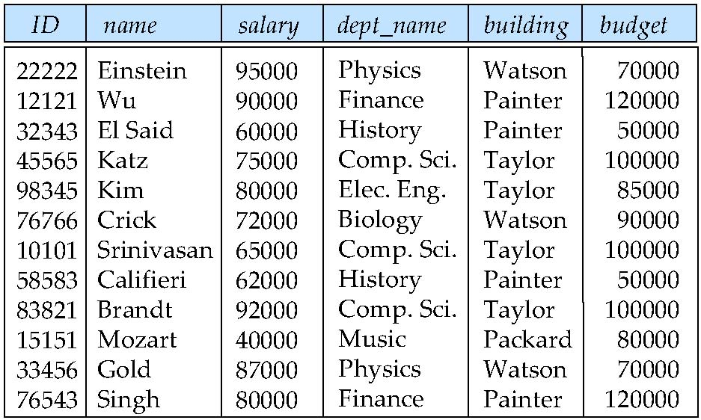
Combine Schemas?
Suppose we combine instructor and department into inst_dept
(No connection to relationship set inst_dept)
Result is possible repetition of information

Slide 5
A Combined Schema Without Repetition
Consider combining relations
sec_class(sec_id, building, room_number) and
section(course_id, sec_id, semester, year)
into one relation
section(course_id, sec_id, semester, year, building, room_number)
No repetition in this case

Slide 6
First Normal Form
Domain is atomic if its elements are considered to be indivisible units
Examples of non-atomic domains:
Set of names, composite attributes
Identification numbers like CS 101 that can be broken up into parts
A relational schema R is in first normal form if the domains of all attributes of R are atomic
Non-atomic values complicate storage and encourage redundant (repeated) storage of data
Example: Set of accounts stored with each customer, and set of owners stored with each account
We assume all relations are in first normal form

Slide 7
First Normal Form (Cont’d)
Atomicity is actually a property of how the elements of the domain are used.
Example: Strings would normally be considered indivisible
Suppose that students are given ID numbers which are strings of the form CS0012 or EE1127
If the first two characters are extracted to find the department, the domain of roll numbers is not atomic.
Doing so is a bad idea: leads to encoding of information in application program rather than in the database.

Slide 8
Goal — Devise a Theory for the Following
Decide whether a particular relation R is in “good” form.
In the case that a relation R is not in “good” form, decompose it into a set of relations {R₁, R₂, ..., R_{n}} such that
each relation is in good form
the decomposition is a lossless-join decomposition
Our theory is based on:
functional dependencies
multivalued dependencies

Slide 9
Redundancy
Same information at many places in the DB
Problems:
Wastage of Space
Update Anomalies
Update Anomaly
Insert Anomaly
Delete Anomaly
Normalization is used for “minimizing” redundancy

Slide 10
Update Anomalies
Consider the relation:
EMP_PROJ ( Emp#, Proj#, Ename, Pname, No_hours)
Update Anomaly: Changing the name of project number P1 from “Billing” to “Customer-Accounting” may cause this update to be made for all 100 employees working on project P1
Insert Anomaly: Cannot insert a project unless an employee is assigned to it
Inversely - Cannot insert an employee unless he/she is assigned to a project.
Delete Anomaly: When a project is deleted, it will result in deleting all the employees who work on that project. Alternately, if an employee is the sole employee on a project, deleting that employee would result in deleting the corresponding project

Slide 11
Solution
Decompose the relation:
EMP_PROJ ( Emp#, Proj#, Ename, Pname, No_hours)
Into the following smaller relations:
EMP (Emp#, Ename)
PROJ (Proj#, Pname)
EMP_PROJ ( Emp#, Proj#, No_hours)
What happened to update anomalies?
We need to find out the basis for decomposing a relation to get rid of update anomalies

Slide 12
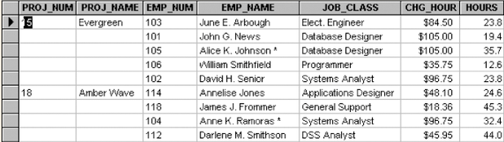
Need for Normalization

Slide 13
Observations
PRO_NUM intended to be primary key
Table entries invite data inconsistencies
Table displays data anomalies
Update
Modifying JOB_CLASS
Insertion
New employee must be assigned project
Deletion
If employee deleted, other vital data lost

Slide 14
Redundancy
Integrity constraints, in particular functional dependencies, can be used to identify schemas with such problems and to suggest refinements.
Main refinement technique: decomposition (replacing ABCD with, say, AB and BCD, or ACD and ABD).
Decomposition should be used judiciously:
Is there a reason to decompose a relation?
What problems (if any) does the decomposition cause?
Notes:
14

Slide 15
Functional Dependencies
Constraints on the set of legal relations
Require that the value for a certain set of attributes determines uniquely the value for another set of attributes
A functional dependency is a generalization of the notion of a key

Slide 16
Functional Dependencies
A functional dependency X Y holds over relation R if, for every allowable instance r of R:
t1 r, t2 r, (t1) = (t2) implies (t1) = (t2)
i.e., given two tuples in r, if the X values agree, then the Y values must also agree. (X and Y are sets of attributes.)
An FD is a statement about all allowable instances of a relation
Must be identified based on semantics of application.
Given some allowable instance r1 of R, we can check if it violates some FD f, but we cannot tell if f holds over R!
K is a candidate key for R means that K R
Notes:
15

Slide 17
Functional Dependencies
Let R be a relation schema
α ⊆ R and β ⊆ R
The functional dependency
α → β
holds on R if and only if for any legal relations r(R), whenever any two tuples t₁ and t₂ of r agree on the attributes α, they also agree on the attributes β. That is,
t₁[α] = t₂ [α] ⇒ t₁[β ] = t₂ [β ]
Example: Consider r(A,B ) with the following instance of r.
On this instance, A → B does NOT hold, but B → A does hold.
4
1 5
3 7

Slide 18
Functional Dependencies
A ➔ B
A’s
B’s
t
u
If t & u agree here
Then they must agree here

Slide 19
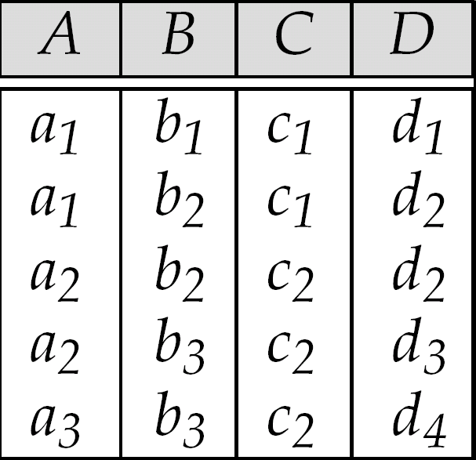
A→C?? C→A ??

Slide 20
Functional Dependencies
We use functional dependencies to:
test relations to see if they are legal under a given set of functional dependencies.
If a relation r is legal under a set F of functional dependencies, we say that r satisfies F.
specify constraints on the set of legal relations
We say that F holds on R if all legal relations on R satisfy the set of functional dependencies F.

Slide 21
Functional Dependencies
K is a superkey for relation schema R if and only if K → R
K is a candidate key for R if and only if
K → R, and
for no α ⊂ K, α → R
Functional dependencies allow us to express constraints that cannot be expressed using superkeys. Consider the schema:
bor_loan = (customer_id, loan_number, amount )
We expect this functional dependency to hold:
loan_number → amount
but would not expect the following to hold:
amount → customer_name

Slide 22
Functional Dependencies
A functional dependency α → β is trivial if β ⊆ α
Example:
customer_name, loan_number → customer_name
customer_name → customer_name

Slide 23
Functional Dependencies
Consider the relation:
PLOTS (prop#, state, plot#, area, price, Tax_rate)
Information about plots available in India. The constraints on the relation are:
Prop# is unique throughout India
Plot# are unique within a given state
For a given_state, tax_rate is fixed
Plots having the same area have the same price, irrespective of the state in which they are located
Write all the FDs on the relation PLOTS

Slide 24
Functional Dependencies
PLOTS
Prop# | State | Plot# | Area | Price | Tax_rate
FD1
PK
FD2
CK
FD3
FD4
Identify redundancy in PLOTS
Identify update anomalies in PLOTS

Slide 25
Functional Dependencies
PLOTS
Prop#
State
Plot#
Area
FD1
PK
FD2
CK
State
Tax_rate
Area
Price
FD3
FD4

Slide 26
Conversion to 1NF
A relational schema R is in first normal form if the domains of all attributes of R are atomic
Repeating groups must be eliminated
Proper primary key developed
Uniquely identifies attribute values (rows)
Combination of PROJ_NUM and EMP_NUM
Dependencies can be identified
Desirable dependencies based on primary key
Less desirable dependencies
Partial
based on part of composite primary key
Transitive
one nonprime attribute depends on another nonprime attribute

Slide 27
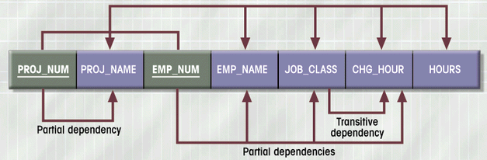
Dependency Diagram (1NF)
Figure 4.4

Slide 28
1NF Summarized
Each attribute must be atomic (single value)
No repeating columns within a row (composite attributes)
No multi-valued columns.
All key attributes defined
All attributes dependent on primary key
1NF simplifies attributes
Queries become easier.

Slide 29
Conversion to 2NF
Start with 1NF format:
Write each key component on separate line
Write original key on last line
Each component is new table
Write dependent attributes after each key
PROJECT (PROJ_NUM, PROJ_NAME)
EMPLOYEE (EMP_NUM, EMP_NAME, JOB_CLASS, CHG_HOUR)
ASSIGN (PROJ_NUM, EMP_NUM, HOURS)

Slide 30
Second Normal Form (2NF)
Each attribute must be functionally dependent on the primary key.
If the primary key is a single attribute, then the relation is in 2NF
The test for 2NF involves testing for FDs whose left-hand-side attribute are part of the primary key
Disallow partial dependency, where non-keys attributes depend on part of a composite primary key
In short, remove partial dependencies
2NF improves data integrity.
Prevents update, insert, and delete anomalies.

Slide 31
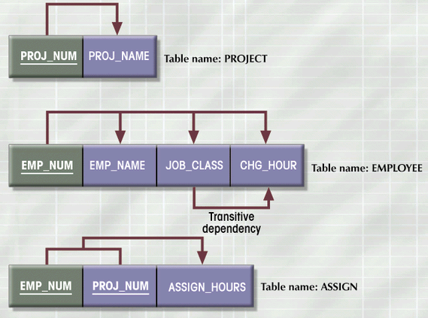
2NF Conversion Results
Figure 4.5

Slide 32
2 NF
Based on the concept of Full FDs (FFD)
If A & B are sets of attributes of R, B is said to be FFD on A if A➔B, but no proper subset of A determines B
No partial dependencies on the PK
Is PLOTS in 2NF?
YES
Single attribute PK
All relations with single attribute PK are in 2 NF!!
2 NF applies to relations with composite keys

Slide 33
2 NF
A relation that is in 1NF & every non-PK attribute is fully functionally dependent on the PK, is said to be in 2 NF
1 NF
Remove all
2 NF
Partial Dependencies

Slide 34
2NF Summarized
In 1NF
Includes no partial dependencies
No attribute dependent on a portion of primary key
Still possible to exhibit transitive dependency
Attributes may be functionally dependent on nonkey attributes

Slide 35
Conversion to 3NF
Create separate table(s) to eliminate transitive functional dependencies
PROJECT (PROJ_NUM, PROJ_NAME)
ASSIGN (PROJ_NUM, EMP_NUM, HOURS)
EMPLOYEE (EMP_NUM, EMP_NAME, JOB_CLASS)
JOB (JOB_CLASS, CHG_HOUR)

Slide 36
3 NF
Based on the concept of transitive dependency
No non-PK attribute should be transitively dependent on the PK
Transitive Dependency
If A➔B & B➔C, then A transitively determines C through B, provided B & C do not determine A
Is PLOTS in 3NF?
NO

Slide 37
3 NF
PLOTS
Prop# | State | Plot# | Area | Price | Tax_rate
FD1
PK
FD2
CK
FD3
FD4
Prop# transitively determines tax_rate through state
Prop# transitively determines price through area

Slide 38
3 NF
A relation that is in 1NF & 2 NF & no non-PK attribute is transitively dependent on the PK, is said to be in 3 NF
2 NF
Remove all
3 NF
Transitive Dependencies

